Slide 1



Space-charge effects in simulations of large avalanche dynamics
Tom Szwarcer | University of Oxford
Supervisors: Djunes Janssens, Heinrich Schindler

Slide 2
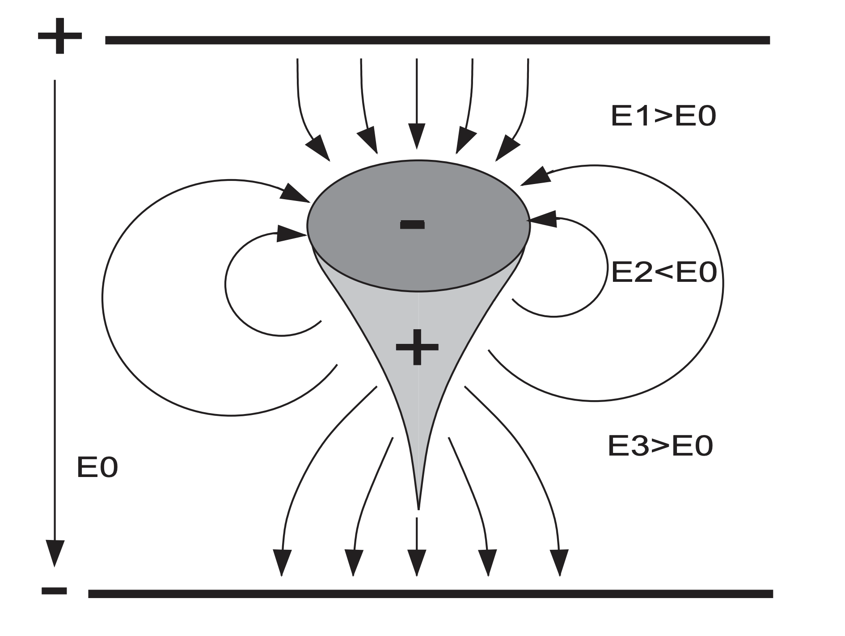
The space charge effect
During avalanches, non-negligible fields may arise from the space charge distribution
These charges modify the background applied field
A significant background field modification may lead to a gain modification
C. Lippmann, W. Riegler, Nuclear Instruments and Methods in Physics Research A 517 (2004) 54–76
Notes:
The field modification may affect gain as gas parameters such as Townsend coefficient depend on the electric field.

Slide 3
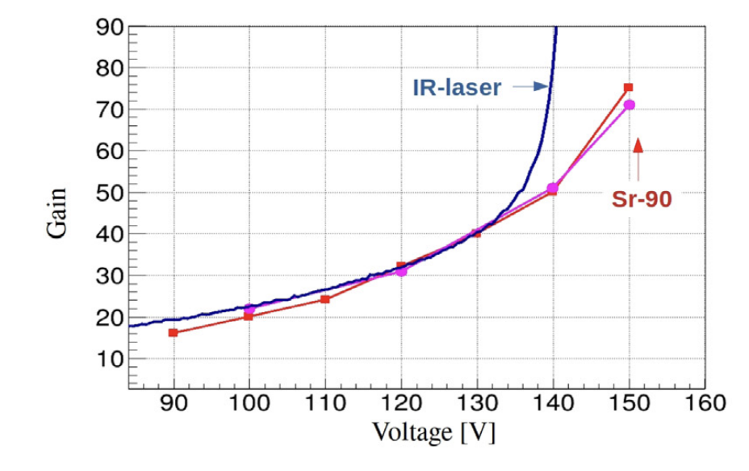
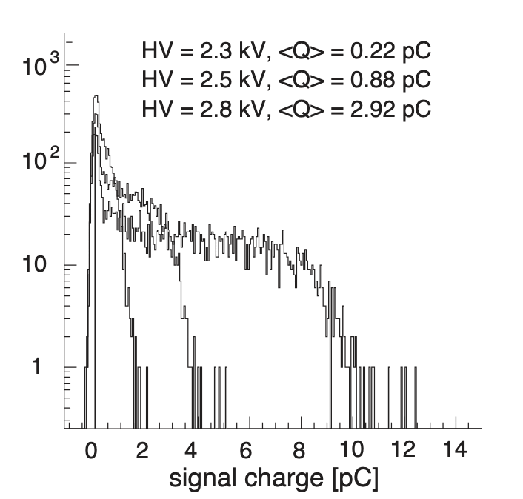
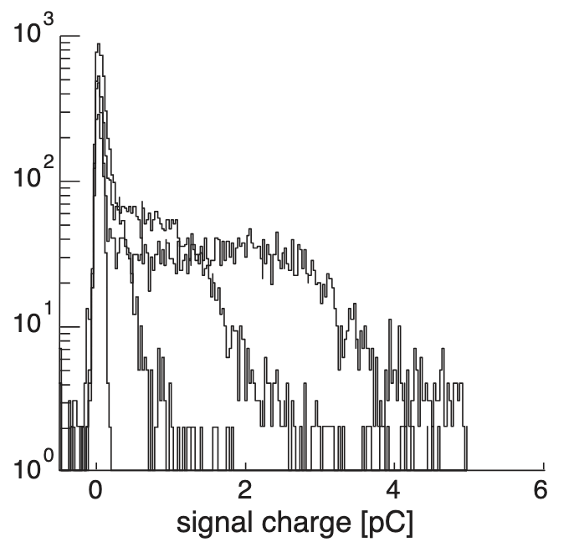
The space charge effect
LGADs: we see a gain reduction for a larger number of starting charges
RPCs: we see a gain-limiting effect
C. Lippmann, W. Riegler / Nuclear Instruments and Methods in Physics Research A 517 (2004) 54–76
E. Currás, M. Fernández and M. Moll, Nuclear Inst. and Methods in Physics Research, A 1031 (2022) 166530
LGAD gain reduction with the higher charge deposition of the Sr-90 source compared to IR laser.
Charge spectra for an RPC
Left: simulation without the space charge effect
Right: measurement
Notes:
Here are some signatures of the space charge effect that we see in our detectors.

Slide 4
Space charge in Garfield++
Based on the work of C. Lippmann, W. Riegler, Nuclear Instruments and Methods in Physics Research A 517 (2004) 54–76
Existing space charge implementation (AvalancheGridSpaceCharge) | Goals of this project
Electrons are transported between nodes of a grid | Allow electrons to be transported arbitrarily by AvalancheMicroscopic
Ions are not transported | Allow ions to be transported arbitrarily by AvalancheMC
Limited to an RPC | Use a general geometry
Uses axisymmetric rings of charge, with the possibility of using a parallel plate boundary condition (i.e. mirror charges) | Compare the use of charged rings to a point charge approach* and investigate whether the free space boundary condition is ‘good enough’
*In this presentation we will focus on the charged ring approach only.

Slide 5
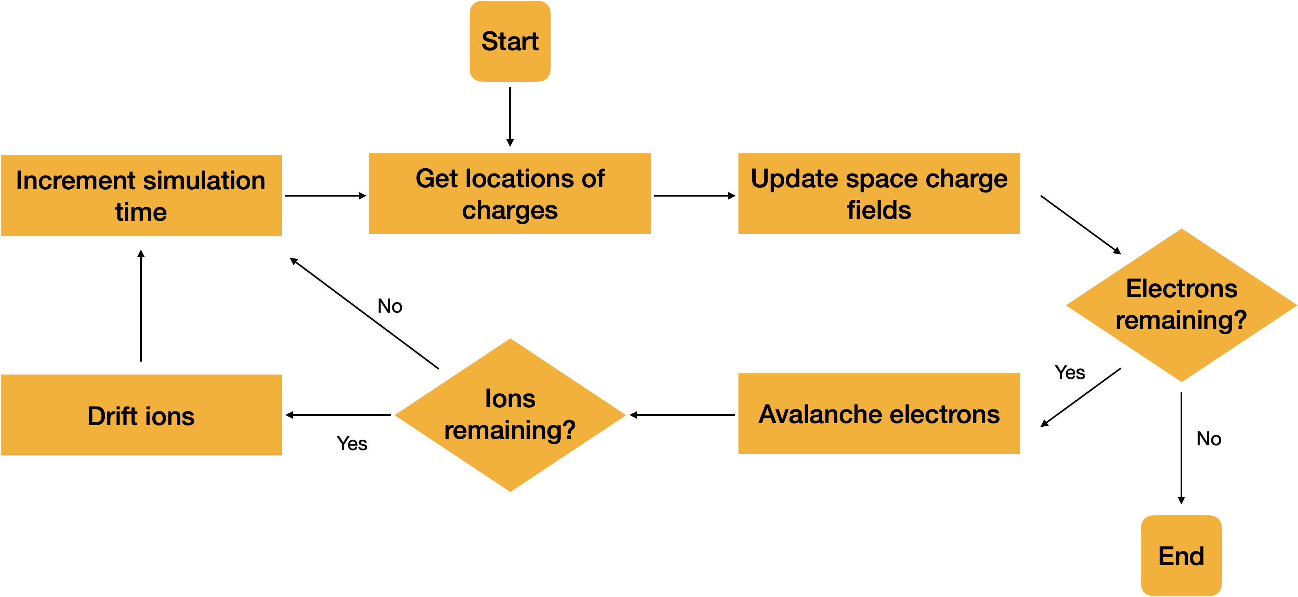
Structure of the simulations
Divide simulations into time windows
Add the fields of any new charges (e.g. those created from ionisation) after the time window
We should keep time windows short: if there’s large amplification over a time window there may be many charges unaccounted for
An adaptive time window approach was implemented to manage this issue
Notes:
The space charge field is updated after each time window, which means the locations of all the charges are requested and the corresponding field is calculated. However, if there is high amplification over a time window, the large number of new charges will not have their fields accounted for until after the time window. An adaptive time window was implemented to limit amplification over a time window.

Slide 6
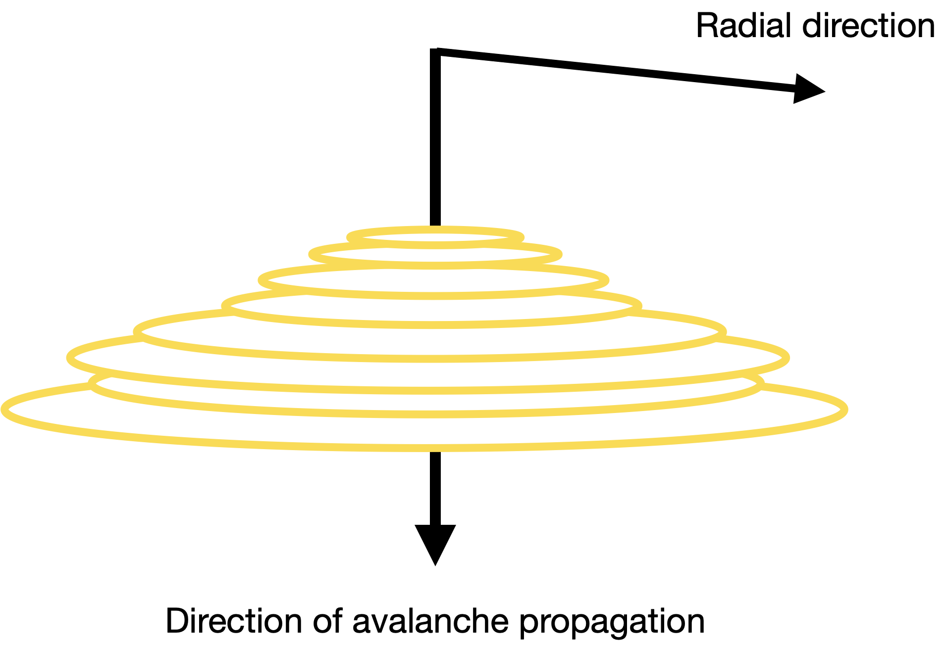
Axisymmetric approximation
Approximate the avalanche as having cylindrical symmetry
The radius is centred on the mean position of the particles
Free space boundary condition used
Notes:
Instead of point charges we use charged rings. The advantage of doing this is we can make use of the symmetry to reduce computation time, as we will see later.

Slide 7
ComponentChargedRing
A new class was created: ComponentChargedRing
Charges can be added at arbitrary positions in 3D space and are converted to charged rings
Symmetry axis can be dynamically updated to track the mean position of the avalanche
Functions to handle divergences were written
Functions to add, remove, and merge rings were added
Functions borrowed from AvalancheGridSpaceCharge as well as new functions were profiled line-by-line with Valgrind/Callgrind; significant optimisations were made
Notes:
Adding charges at arbitrary positions allows for easy interfacing with AvalancheMicroscopic/MC, which can easily return the locations of the charges it simulates.

Slide 8
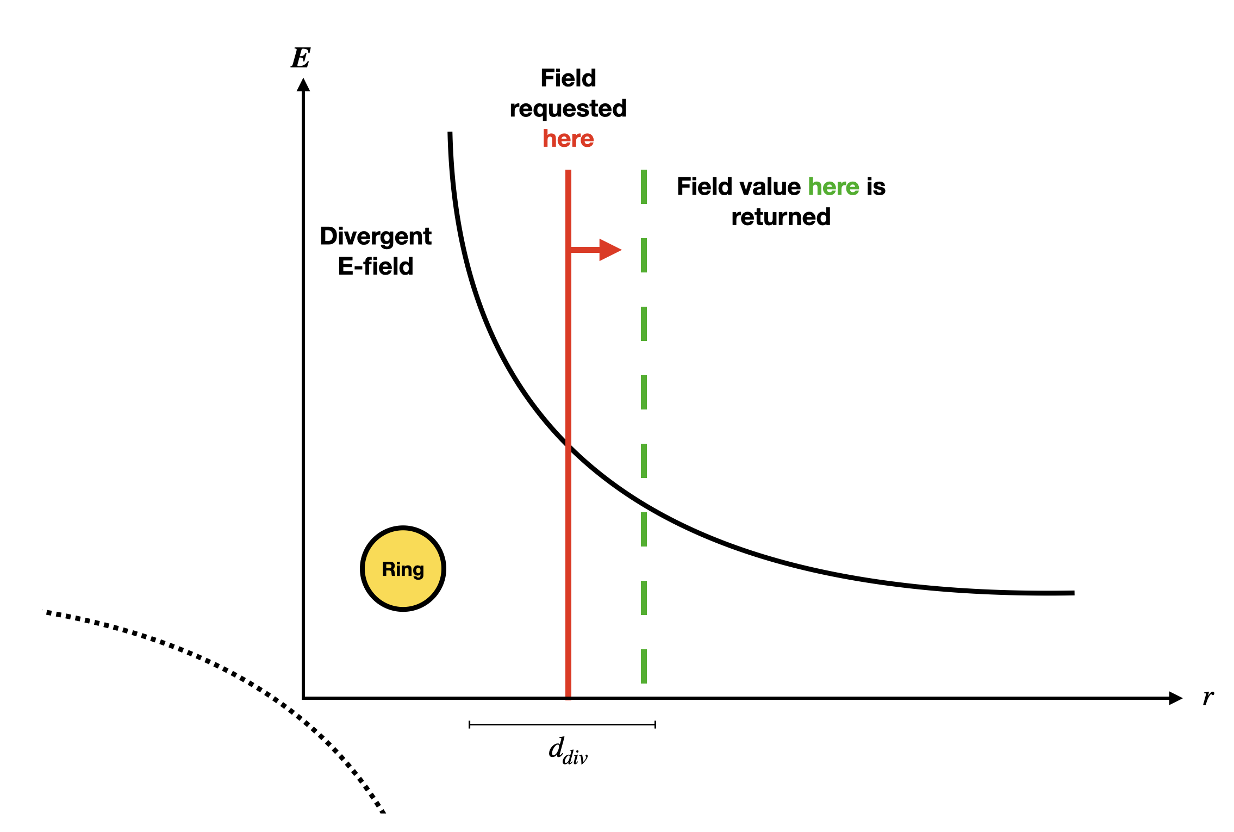
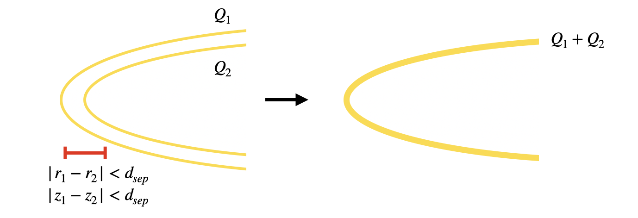
ComponentChargedRing: tolerances
Ring separation tolerance
If two rings are closer together than this tolerance, they will be merged
Rings added with a radius less than this tolerance are added as point charges on the axis of symmetry
This can be used to limit the number of rings, and reduce computation time
Divergence-handling tolerance
If the electric field is requested within one tolerance of a ring or point charge, the field value one tolerance away is returned instead
An efficient check of whether there are divergences was implemented
Logic was written to preserve the sign of the field, using the relative position of the ring and field point
Notes:
I want to briefly cover the tolerances as they are important to understanding how ComponentChargedRing works.
The reason we use point charges on the symmetry axis is that otherwise we would have a ‘smallest ring’ with a large amount of charge, which seems less physical.

Slide 9
Simulating with ComponentChargedRing
How many charges are needed to significantly modify the field?
Using an applied field of 44kV/cm, in a parallel plate setup
These plots show the end of the avalanche, when all electrons have been evacuated
We start to see significant field modifications at 10⁶ ionisations
We add initial electrons at the same place and time to ensure a single large avalanche
Units of the field in the plots are V/cm
1.7×10⁵ ionisations
(20 initial electrons)
1.5×10⁶ ionisations
(200 initial electrons)

Slide 10
Simulating with ComponentChargedRing
Getting to 10⁶ ionisations takes a very long time, even when we limit the number of rings.
Even with optimised code all of this adds up, and large simulations are not feasible unless we use a grid to pre-compute fields before each time window.
For each time window
For each electron
For each time the field is requested
For each ring in the simulation
Retrieve elliptic integral value from a huge array
Perform multiple operations on it to get the correct field
Handle any divergences
Check if the ring should be treated as an on-axis point charge

Slide 11
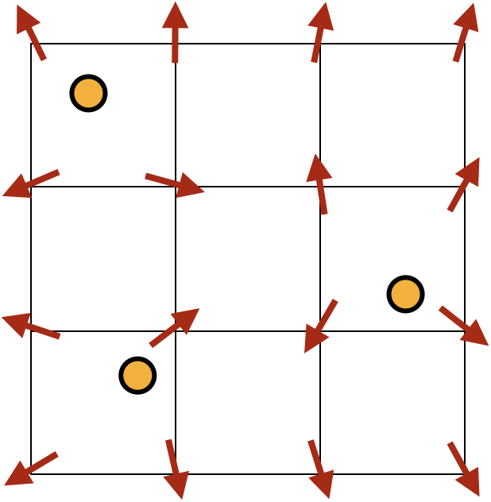
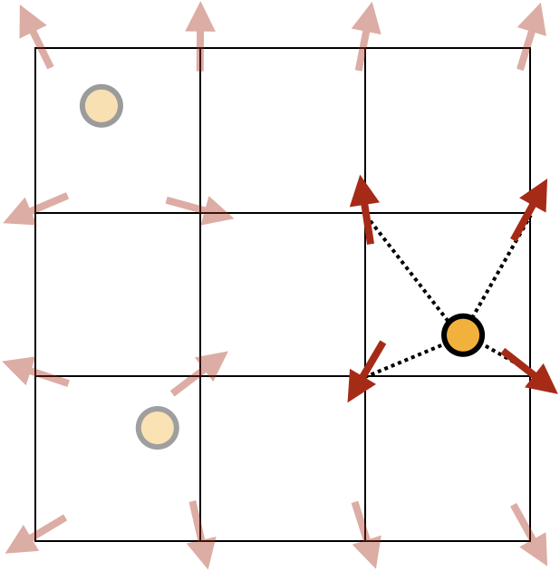
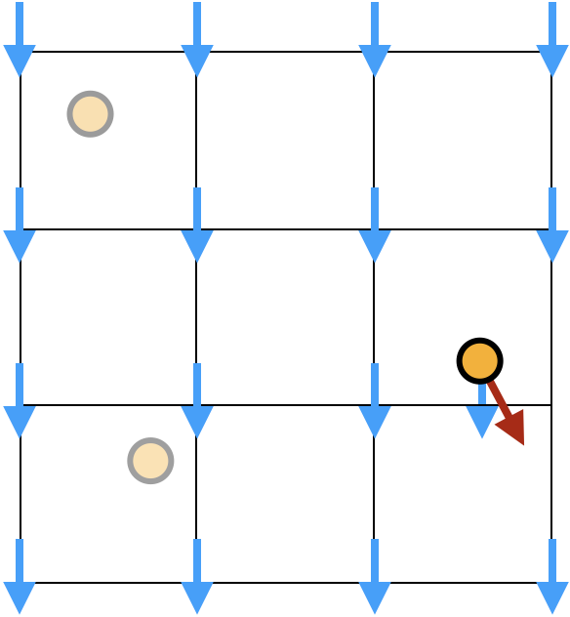
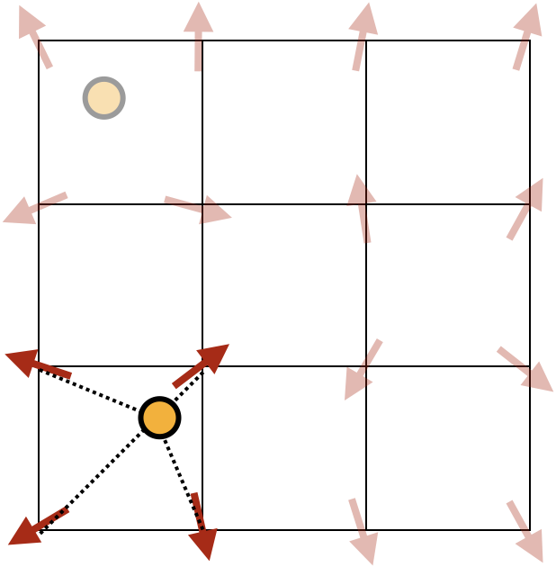
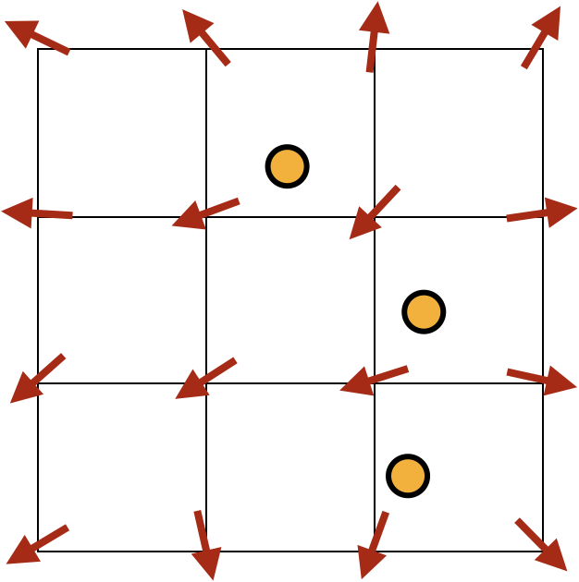
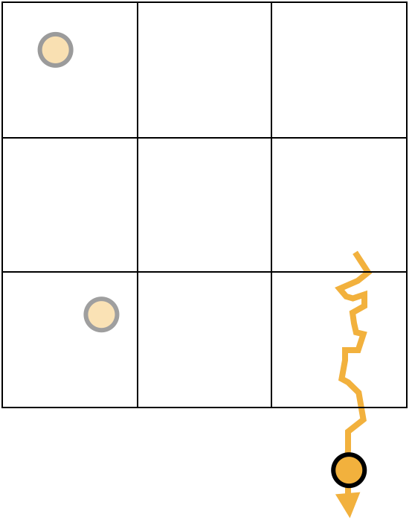
The grid-based approach in microscopic simulations
Background field
Local field
2. Find the local field at a charge’s position by interpolating the field from the nearest nodes
1. Calculate field on the grid nodes from the distribution of charges
3. Add this to the background field at the charge’s position
Local field
6. When all charges have been drifted, recalculate the field for the resulting charge distribution
4. Drift the charge in the presence of these fields
5. Repeat from step 2 for the other charges

Slide 12
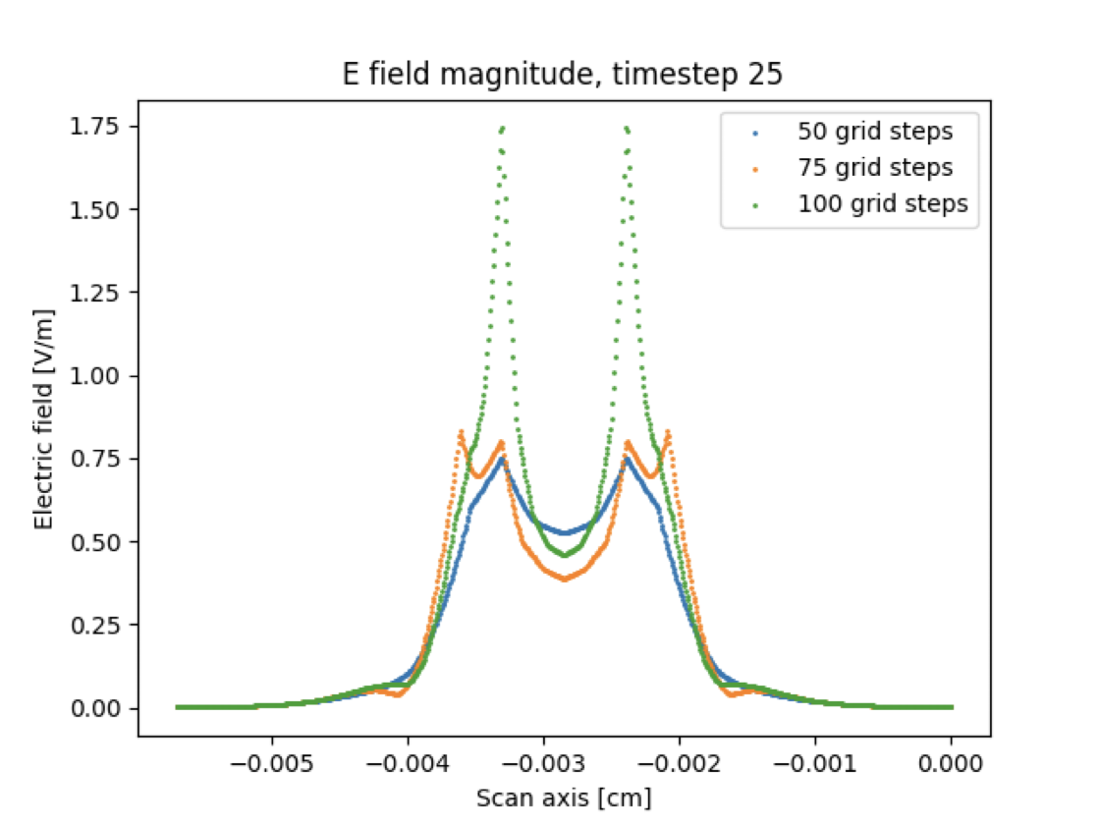
Grid-based approach
2D (r,z) grids are strongly preferred:
The field at each node must be calculated; 3D grids have more nodes to iterate over
A 3D grid implementation won’t give a significant speedup below 10⁶ electrons
ComponentChargedRing can be readily interfaced with grid classes, e.g. ComponentGrid
A basic 2D grid class (ComponentGrid2D) was written, allowing 2.2×10⁶ ionisations to be reached in ~45 mins
The field was found to strongly depend on the grid spacing for coarse grids. It was found to have converged at around ~2×10⁴ nodes/cm in each direction
However, for large numbers of active particles, the field will get smoothed out anyway, so coarser grids could probably be used
Top: field of a single ring, note the interpolation
Bottom: strong dependence of field on grid spacing for coarse grids (no field convergence)
[V/cm]
Notes:
As there are ‘more’ nodes on 3D grids vs 2D grids, there was no benefit to using them for <10^6 electrons. We can’t get to 10^6 electrons in a reasonable amount of time with ComponentChargedRing alone.

Slide 13
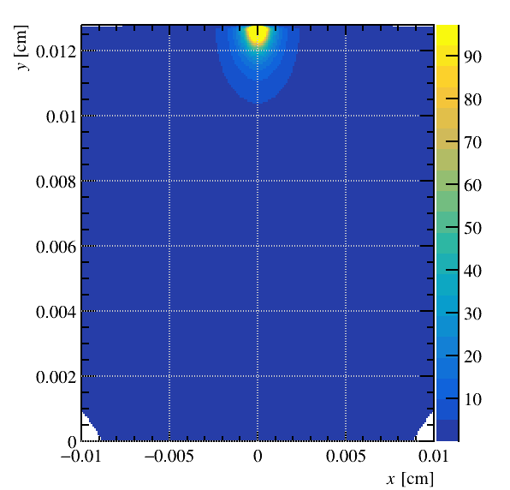
E field magnitude [V/cm]
Background field not included
1.6×10⁶ ionisations
Note the symmetry-induced dip in magnitude along the axis

Slide 14
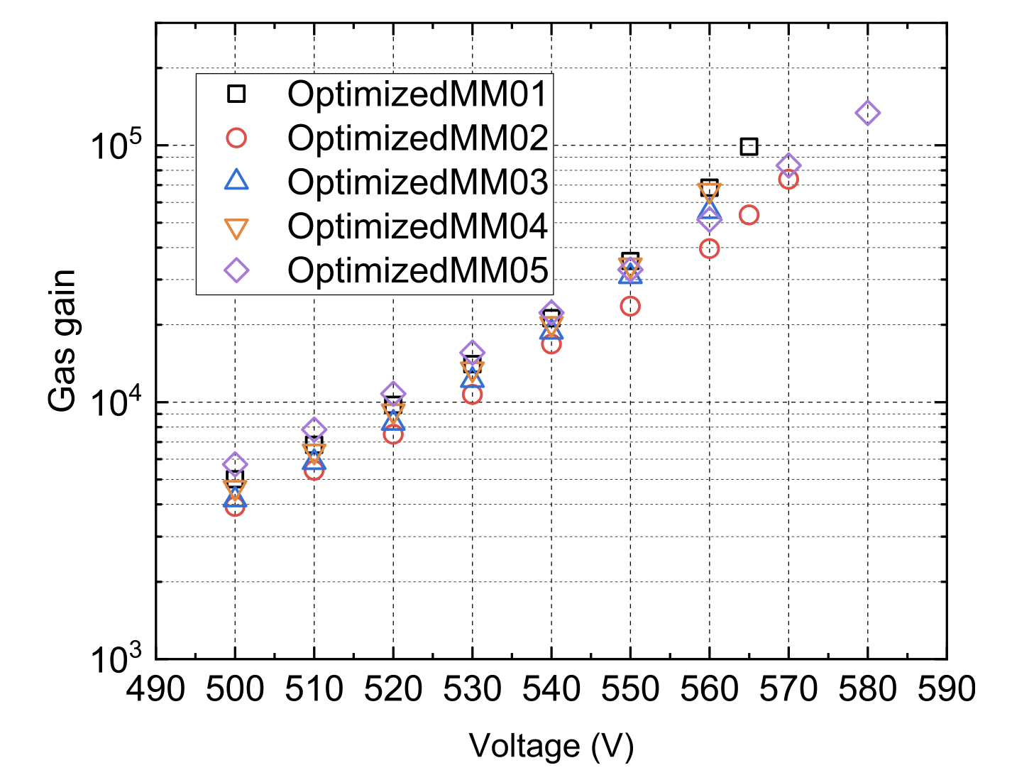
Effect of a resistive anode
To see if space charge could cause superexponential behaviour in resistive Micromegas, the field modification due to a resistive anode was investigated.
Electrons were added as charged rings ‘stuck’ on the anode
There was a field reduction, which would imply a stronger gain limiting effect
So, space charge effects probably aren’t the cause
Notes:
Super-exponential behaviour was observed in resistive Micromegas, and space charge was one possible explanation. The field was found to be reduced with a resistive anode, ruling it out.

Slide 15
Effect of the space charge field on gain
Parallel plate geometry
d = 128µm, dv = 540V
200 electrons added at the same location and time in each run
We see a gain limiting effect, which we expect due to the field reduction
Space charge enabled: µ = 9.52×10⁵, SD = 1539, N = 696
Space charge disabled: µ = 1.05×10⁶, SD = 1506, N = 1100
Notes:
The gain limiting effect due to the field modification was reproduced in a parallel plate geometry.

Slide 16
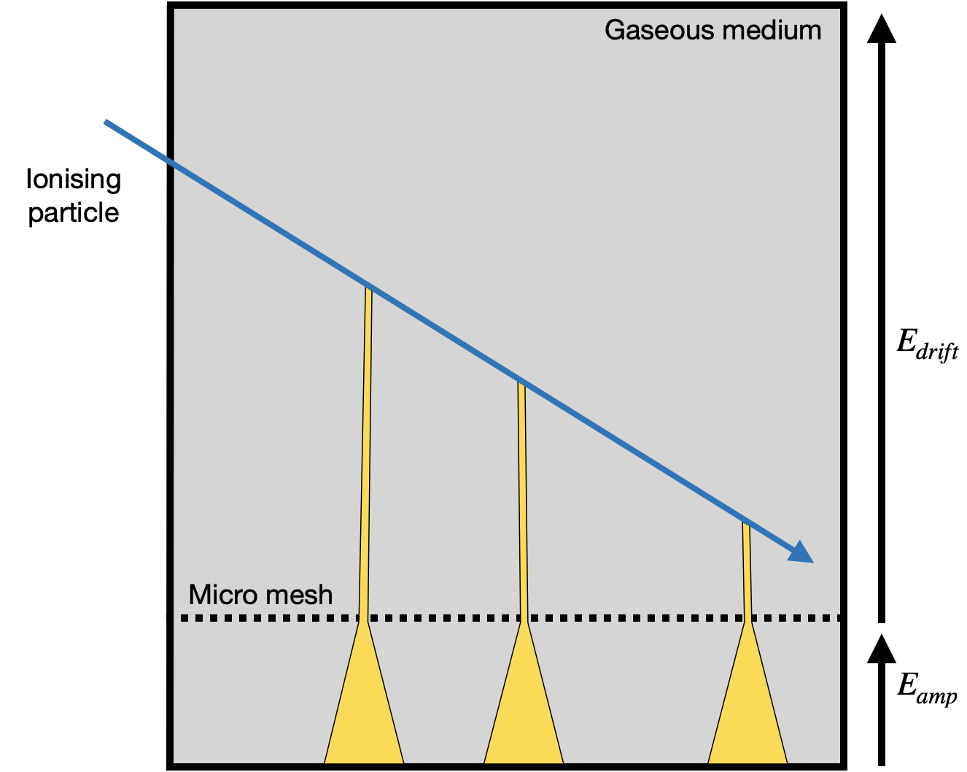
Multiple ring systems
Up to now we have been dealing with a single system of charged rings
With real detectors in mind, we are more interested in having multiple systems active at once
We get multiple ring systems when:
We have multiple clusters formed from a track
Charges from a deposition in a ‘blob’ diffuse away from each other
Axis 1
Axis 2
Axis 3
We need a separate symmetry axis for each ring system

Slide 17
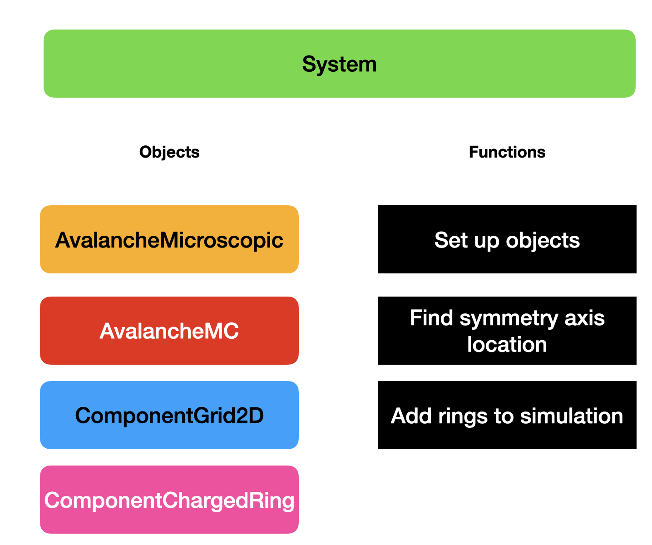
Multiple ring systems
Use a vector of System objects
We need one Avalanche object per system so that we can keep track of which particles are in which system.
We need one ComponentGrid2D and ComponentChargedRing object per system as both use symmetry axes, and there is a unique axis per system
We use a single Sensor object. This ensures all particles feel the field from all systems.

Slide 18
Multiple ring systems
Background field not included as the space charge field was weak (~10³ charges per ring system). Units are V/cm.
Top: drift lines (electrons, ions)
Bottom: space charge E-field magnitude

Slide 19
Conclusion
Project report viewable here
A semi-analytic, axisymmetric approach for including the space charge effect in microscopic simulations was investigated
The new class ComponentChargedRing was added to Garfield++
Grid-based and grid-free approached were investigated
Charge densities required for significant field modification were investigated
Effect of using a resistive anode was investigated
A gain limiting effect was observed
Proof of concept technique of simulating multiple ring systems was developed and applied to a Micromegas
Future work: compare to FEM/neBEM approaches, apply this method to LGADs

Slide 20
Questions

Slide 21
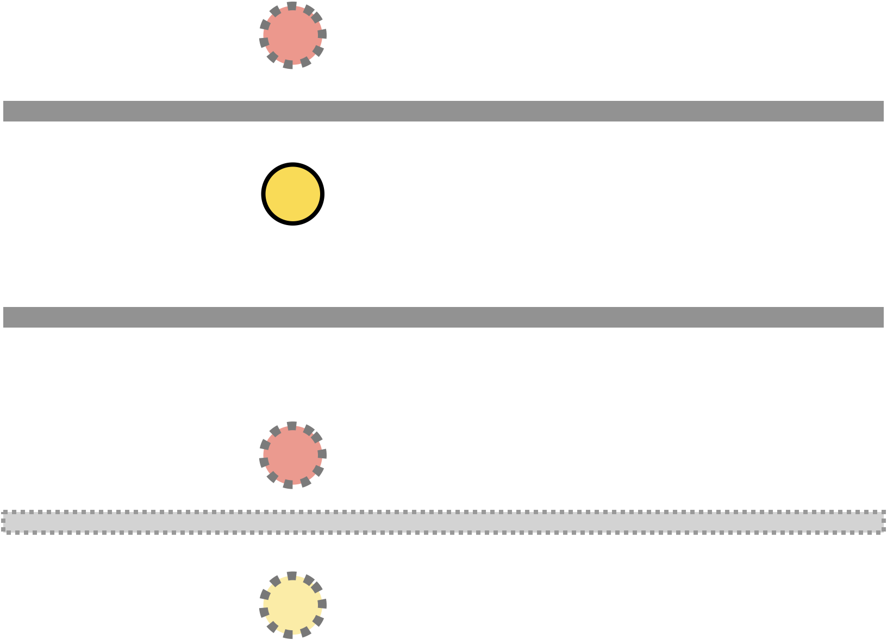
Point charge approach
For a point charge in a parallel plate, the analytic field expression involves infinitely many mirror charges
These can be expressed as an integral over a Bessel function
This is expensive to compute, so a grid is used for efficiency
We pre-compute the field maps on the grid and use symmetry to reduce memory usage
Mirror charges

Slide 22
Point charges
There is good agreement between free charged rings and point charges except at the anode
Here, mirror charges from the parallel plate boundary condition cause the field to be modified
Computation time and memory space are limiting factors
Comparison of the electric field for different approaches to space charge effect simulations

